Slide 1
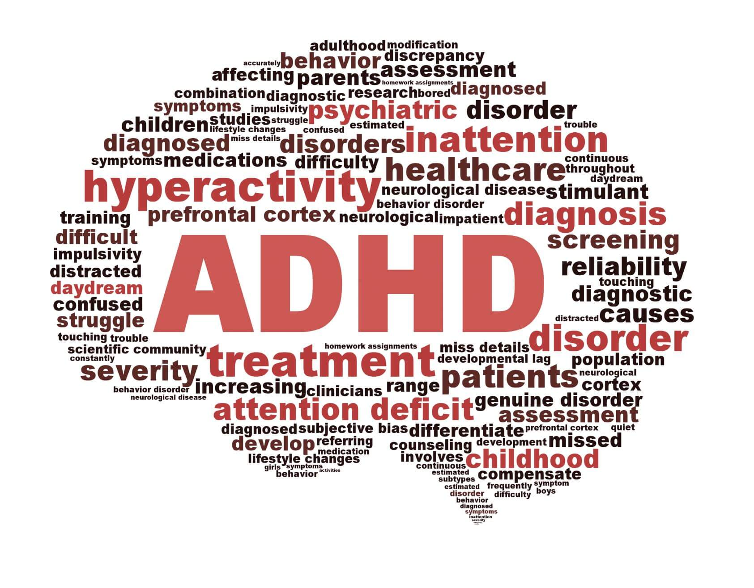
Machine Learning-Based Polysomnography Data Analysis for ADHD Diagnosis: A Focus on Sleep Stage-Based Biomarkers
40th Southern Biomedical Engineering Conference (SBEC)
Amirhossein Eskorouchi
Dr. Haifeng Wang
Dr. Junfeng Ma
Industrial and Systems Engineering
Mississippi State University
September, 2024

Slide 2
Content
Introduction
Related Works
Methodology
Experimental Results
Discussion
Conclusion and Future Work

Slide 3
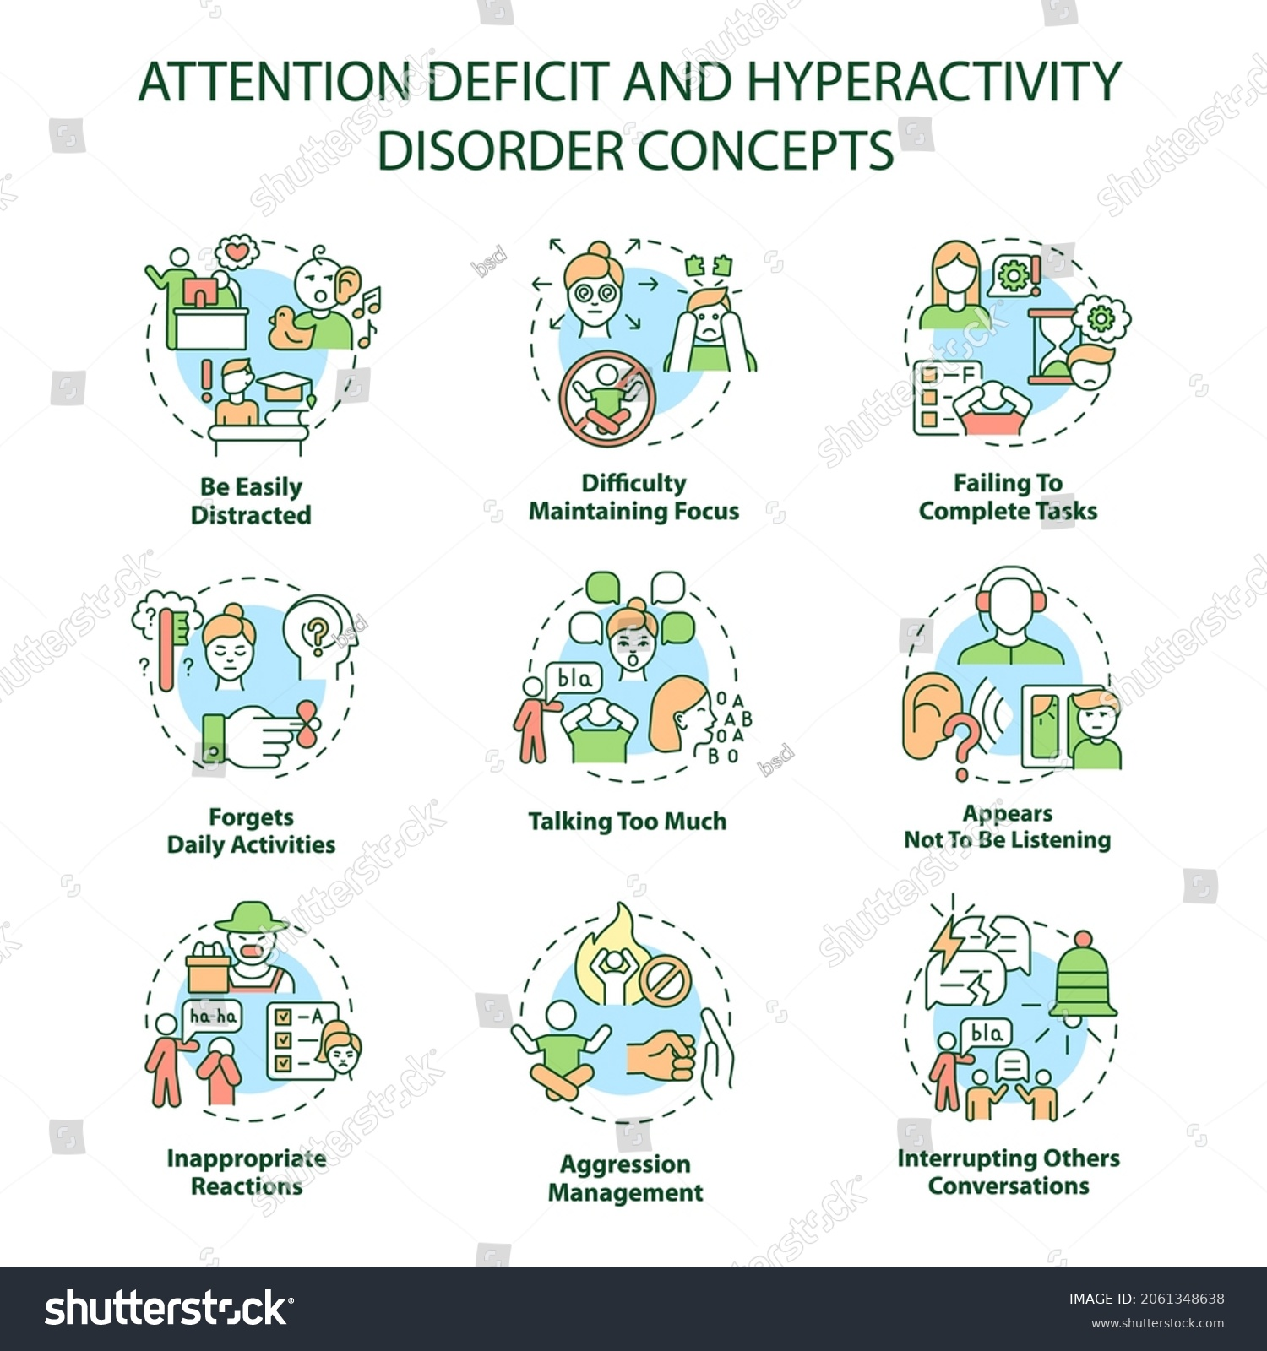
Introduction
Attention Deficit Hyperactivity Disorder (ADHD) is a prevalent neurodevelopmental disorder that affects approximately 7.6% of children and 6.76% of adults globally, characterized by inattention, hyperactivity, and impulsive behavior.
Current Diagnostic Challenges:
Subjective Assessments | Variability
Misdiagnosis Risks | Delayed Diagnosis
Need for Objective Biomarkers— biological indicators that can reliably diagnose ADHD.
Primary Aim is to enhance ADHD diagnostic accuracy by identifying sleep stage-based biomarkers using polysomnography (PSG) data and machine learning techniques.

Slide 4
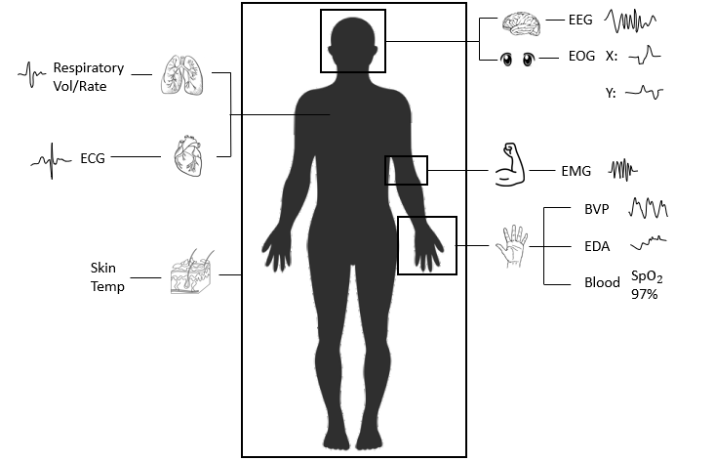
Related works
Key areas of focus in previous researches:
Graph Theory in ADHD Diagnosis
Multimodal Biomarkers
Machine Learning Applications
Year | Explainability | Multi-Channel | Validation Method | Data Type | Study Type | Ref
2018 | ✓ | ✓ | Holdout Set | MRI, FMRI | Numerical
2020 | × | × | Cross-Validation | Auditory Evoked | Numerical
2022 | ✓ | ✓ | Cross-Validation | EEG | Numerical
2022 | ✓ | ✓ | Cross-Validation | Eye-Tracking, CPT | Case Study
2023 | ✓ | ✓ | Cross-Validation | EEG, EOG | Numerical
2024 | ✓ | ✓ | Nested Cross-Validation | EEG, EOG, ECG, EMG | Case Study
Our Contribution:
Integrating electroencephalogram (EEG), electrooculography (EOG), Electromyography (EMG), and Electrocardiogram (ECG) for a comprehensive and multimodal analysis.
Focusing on sleep stage transitions as dynamic biomarkers for ADHD diagnosis.
Applying machine learning (Random Forest, nested cross-validation) for an objective and reliable diagnostic tool.

Slide 5
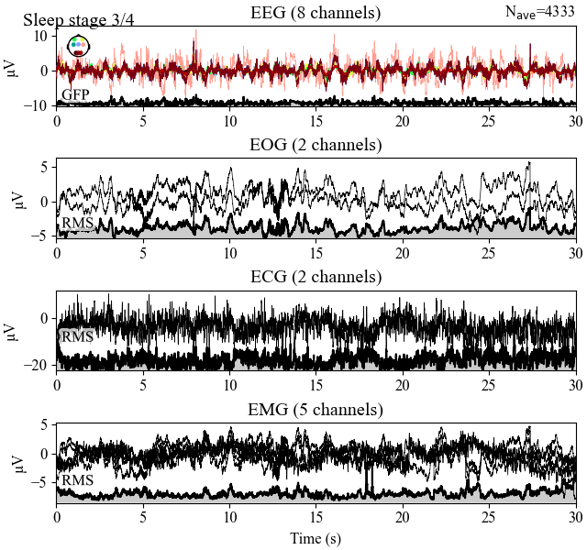
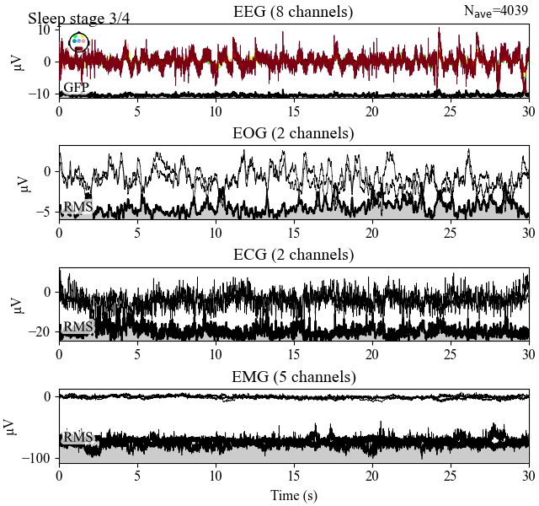
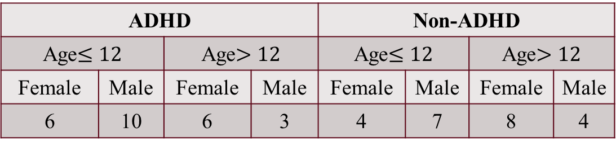
Methodology – Data Acquisition
Study Population:
48 individuals from the University of Mississippi Medical Center (UMMC) pediatric sleep center.
ADHD |  |  |  | Non-ADHD
Age$≤12$ |  | Age$>12$ |  | Age$≤12$ |  | Age$>12$
Female | Male | Female | Male | Female | Male | Female | Male
6 | 10 | 6 | 3 | 4 | 7 | 8 | 4
Polysomnography (PSG) Recordings:
Duration: ~8 hours of sleep data per individual.
Epochs:
20,294 epochs for ADHD,
19,968 epochs for non-ADHD.
Sleep Stages:
Data recorded across five sleep stages:
Stage 1 → Wake,
Stage 2 → Sleep stage1,
Stage 3 → Sleep stage 2,
Stage 4 → Sleep stage 3-4,
Stage 5 → REM (Rapid Eye Movement).
PSG recordings across different channels for sleep stage 2 of a sample epoch for a Non-ADHD (Left) and a ADHD (Right) individual.

Slide 6
Methodology – Data Preprocessing
Physiological signals often contain unwanted artifacts like eye blinks, muscle movements, and environmental noise, which can distort the data and lead to inaccurate results.
EEG Preprocessing:
Reference Electrode Standardization Technique (REST) → Minimizes variability between different electrode placements.
Band-Pass Filtering (1 Hz – 100 Hz) → Removes noise outside the target frequency range
Notch Filter at 60 Hz → Removes interference from power line noise.
EOG, EMG, and ECG Preprocessing:
Synchronization with EEG: Signals from EOG, EMG, and ECG were synchronized with the EEG data to ensure consistency across all channels for multi-modal analysis.

Slide 7
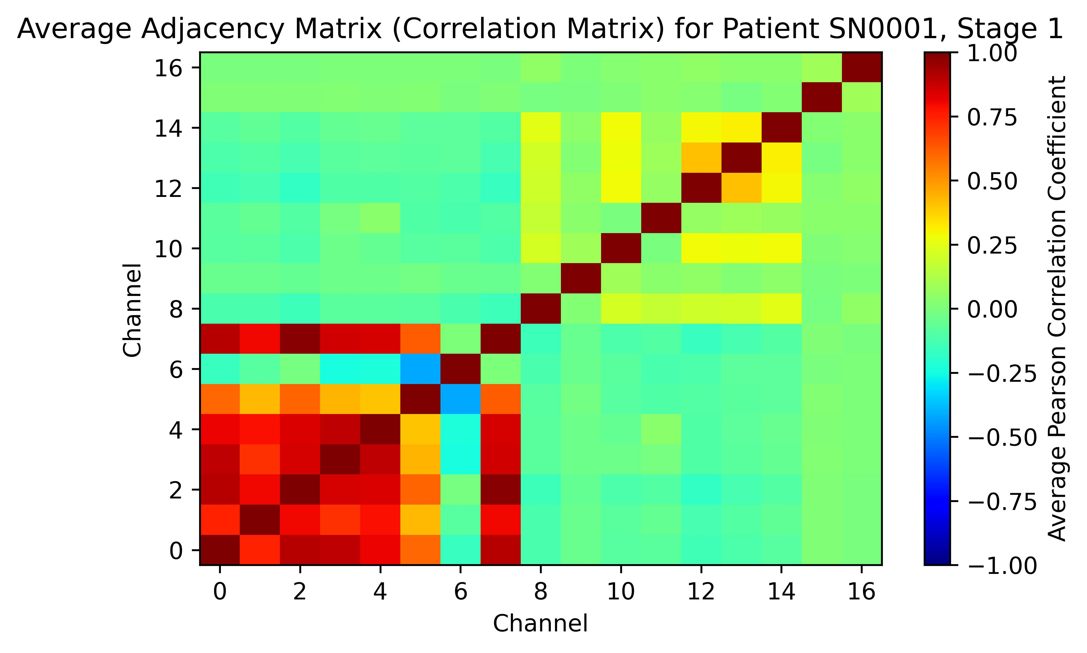
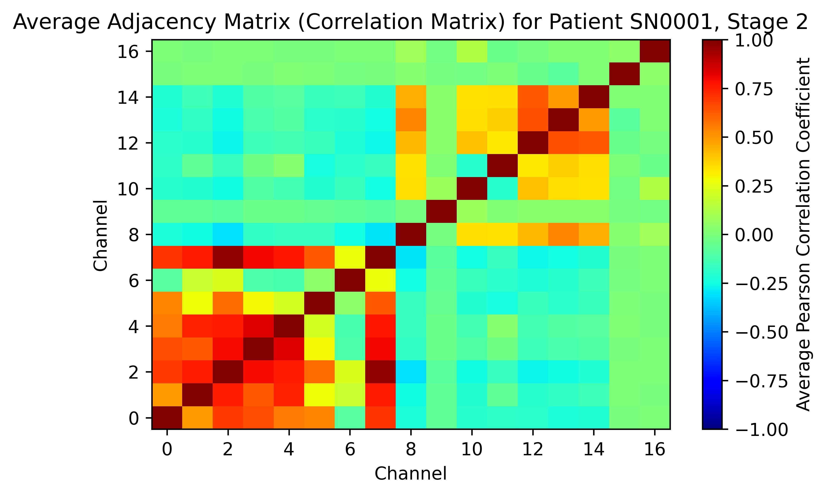
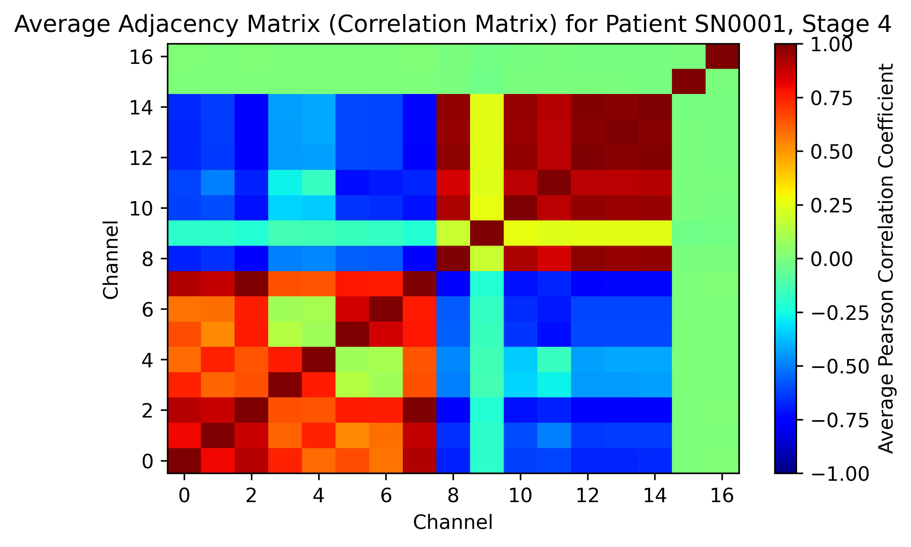
Methodology – Feature Extraction
Calculate the correlation matrices using Pearson correlation coefficients between all pairs of signals across the 17 channels for each 30-second epoch.
The correlation matrices serve as adjacency matrices for graph construction.
The average shortest path length measures the efficiency of communication between physiological systems (e.g., brain-to-eye, brain-to-muscle) for each patient across five sleep stages (Wake, Stage 1, Stage 2, Stage 3-4, REM).
Resulting Feature Vector: A five-dimensional feature vector is created for each patient, where each dimension corresponds to the connectivity during a different sleep stage.
Patients | Features (Average shortest path) |  |  |  |  | Y
 | Wake | Sleep stage 1 | Sleep stage 2 | Sleep stage 3-4 | REM
SN0001 | 0.1014 | 0.0647 | 0.092 | 0.0860 | 0.0690 | 1
.
.
.
.
.
.
.
.
.
.
.
.
.
.
.
.
.
.
.
.
.
SN0048 | 0.0691 | 0.0638 | 0.0679 | 0.0863 | 0.0555 | 1

Slide 8
Methodology – Machine Learning
Random Forest Classifier: Multiple decision trees are built, and the final decision is made by aggregating the predictions from each tree.
Handles high-dimensional data effectively | Robust to overfitting due to its ensemble learning nature
Nested Cross-Validation: Ensures the model is thoroughly tested and avoids overfitting, providing a robust estimate.
Test Set Outer CV | Training Set Outer | Training Set Outer | Training Set Outer | Training Set Outer
Inner CV
Test on the selected model
Validation Inner | Training Inner | Training Inner | Training Inner | Training Inner
Training Inner | Validation Inner | Training Inner | Training Inner | Training Inner
Training Inner | Training Inner | Validation Inner | Training Inner | Training Inner
Outer CV
Training Inner | Training Inner | Training Inner | Validation Inner | Training Inner
Training Inner | Training Inner | Training Inner | Training Inner | Validation Inner
----------------------------
Hyperparameter Tuning (Grid Search CV)
----------------------------
----------------------------
Training set | Training set | Training set | Training set | Test set

Slide 9
Experimental Results
Correlation Coefficient Matrices Between Different Sleep Stages for ADHD and Non-ADHD Individuals
Model Performance
Fold | Accuracy | Precision | Recall | F1-Score
1 | 0.70 | 0.75 | 0.75 | 0.75
2 | 0.68 | 0.62 | 0.89 | 0.73
3 | 0.63 | 0.67 | 0.83 | 0.74
4 | 0.68 | 0.54 | 1.00 | 0.70
5 | 0.89 | 1.00 | 0.80 | 0.89
Average | 0.72 | 0.71 | 0.85 | 0.76
Stage | Wake | Sleep stage1 | Sleep stage2 | Sleep stage3-4 | REM
Wake | 1.00 | 0.61 | 0.63 | 0.48 | 0.59
Sleep stage1 | 0.59 | 1.00 | 0.21 | -0.09 | 0.58
Sleep stage2 | 0.71 | 0.82 | 1.00 | 0.75 | 0.35
Sleep stage3-4 | 0.47 | 0.63 | 0.81 | 1.00 | 0.10
REM | 0.57 | 0.61 | 0.73 | 0.57 | 1.00
A high correlation means when the person moves from one sleep stage to the next, the transition is smooth and consistent. In contrast, a lower correlation means the transition between the two stages may be disrupted or irregular.
Sleep Stage 1-Sleep Stage 3-4 Transitions:
In ADHD individuals, the transition is disrupted, shown by a negative correlation (-0.09), indicating difficulty progressing through the sleep cycle.
In non-ADHD individuals, the positive correlation (0.63) suggests smoother, more regular transitions into deep sleep.

Slide 10
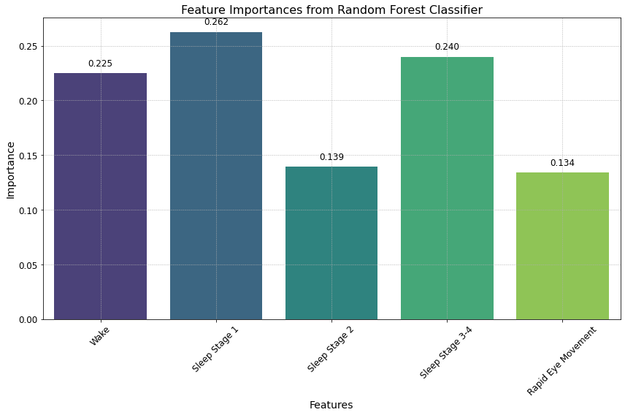
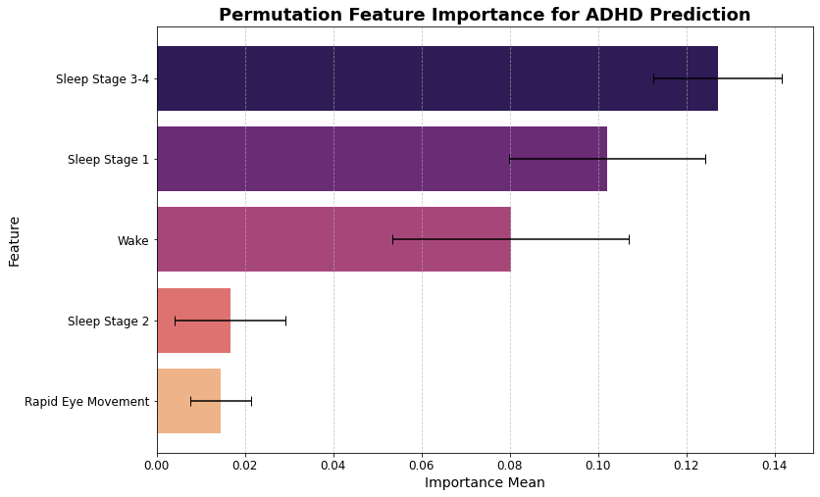
Experimental Results
Before Shuffling: The model performs well, correctly classifying ADHD cases with an accuracy of 72% and a strong recall of 85%.
After Shuffling: The model’s performance drops significantly, particularly in its ability to correctly identify ADHD patients, showing that Stage 1 and Stage 3-4 are crucial features for accurate ADHD classification.

Slide 11
Conclusion
Key findings:
The study demonstrated that Sleep Stage 1 and Sleep Stage 3-4 are critical features for distinguishing ADHD from non-ADHD individuals
The model achieved an average accuracy of 72%, with an F1-score of 76%, showing strong performance in identifying ADHD-related sleep abnormalities.
Significance of the Results:
These findings suggest that ADHD individuals experience disrupted transitions during light sleep (Stage 1) and deep sleep (Stage 3-4), which may explain the sleep-related issues often associated with ADHD.
Future work should expand the dataset and incorporate detailed signal correlation analysis to further understand differences in EEG, EOG, EMG, and ECG signals between ADHD and non-ADHD individuals.

Slide 12
References
D. Demontis et al., “Discovery of the first genome-wide significant risk loci for attention deficit/hyperactivity disorder,” Nat Genet, vol. 51, no. 1, pp. 63–75, Jan. 2019, doi: 10.1038/s41588-018-0269-7.
R. C. Kessler et al., “The World Health Organization adult ADHD self-report scale (ASRS): A short screening scale for use in the general population,” Psychol Med, vol. 35, no. 2, pp. 245–256, Feb. 2005, doi: 10.1017/S0033291704002892.
S. Boccaletti, V. Latora, Y. Moreno, M. Chavez, and D. U. Hwang, “Complex networks: Structure and dynamics,” Physics Reports, vol. 424, no. 4–5. pp. 175–308, Feb. 2006. doi: 10.1016/j.physrep.2005.10.009.
E. Bullmore and O. Sporns, “Complex brain networks: Graph theoretical analysis of structural and functional systems,” Nature Reviews Neuroscience, vol. 10, no. 3. pp. 186–198, Mar. 2009. doi: 10.1038/nrn2575.
M. Rubinov and O. Sporns, “Complex network measures of brain connectivity: Uses and interpretations,” Neuroimage, vol. 52, no. 3, pp. 1059–1069, Sep. 2010, doi: 10.1016/j.neuroimage.2009.10.003.
Bakhtyari M, Mirzaei S. ADHD detection using dynamic connectivity patterns of EEG data and ConvLSTM with attention framework. Biomedical Signal Processing and Control. 2022 Jul 1;76:103708.

Slide 13
References
A. Zalesky et al., “Whole-brain anatomical networks: Does the choice of nodes matter?,” Neuroimage, vol. 50, no. 3, pp. 970–983, Apr. 2010, doi: 10.1016/j.neuroimage.2009.12.027.
S. Achard, R. Salvador, B. Whitcher, J. Suckling, and E. Bullmore, “A resilient, low-frequency, small-world human brain functional network with highly connected association cortical hubs,” Journal of Neuroscience, vol. 26, no. 1, pp. 63–72, Jan. 2006, doi: 10.1523/JNEUROSCI.3874-05.2006.
S. Micheloyannis et al., “Small-world networks and disturbed functional connectivity in schizophrenia,” Schizophr Res, vol. 87, no. 1–3, pp. 60–66, Oct. 2006, doi: 10.1016/j.schres.2006.06.028.
R. Ferri, F. Rundo, O. Bruni, M. G. Terzano, and C. J. Stam, “Small-world network organization of functional connectivity of EEG slow-wave activity during sleep,” Clinical Neurophysiology, vol. 118, no. 2, pp. 449–456, Feb. 2007, doi: 10.1016/j.clinph.2006.10.021.
Ahmadlou M, Adeli H, Wavelet-synchronization methodology: a new approach for EEG-based diagnosis of ADHD. Clin EEG Neurosci 41:1–10, 2010, https://doi.org/10.1177/155005941004100103.
De Vico Fallani F, Richiardi J, Chavez M, Achard S. 2014 Graph analysis of functional brain networks: practical issues in translational neuroscience. Phil. Trans. R. Soc. B 369: 20130521. http://dx.doi.org/10.1098/rstb.2013.0521.

Slide 14

Thank you!

